Slide 1
Using 24GHz RADAR for Contactless Heartrate Monitoring
Presented by: Oisin Watkins
Supervisor: Colin Fitzpatrick
ADI Co-Ordinator: Padraic O’Reilly

Slide 2
Contents
Project Outline and Introduction
Previous Projects
The Board
The Algorithm
Testing the Design
Results
The Data
Conclusions

Slide 3
Project outline
Title was defined by myself and my team while on co-operative placement in Analog.
With ADI joining the self-driving car race, new ways of monitoring passengers while in the vehicle are being experimented with.
Audi have an on-board Emergency contact system in the event of an accident, however it is bare boned. This project is among the first attempts to flesh the idea out further.

Slide 4
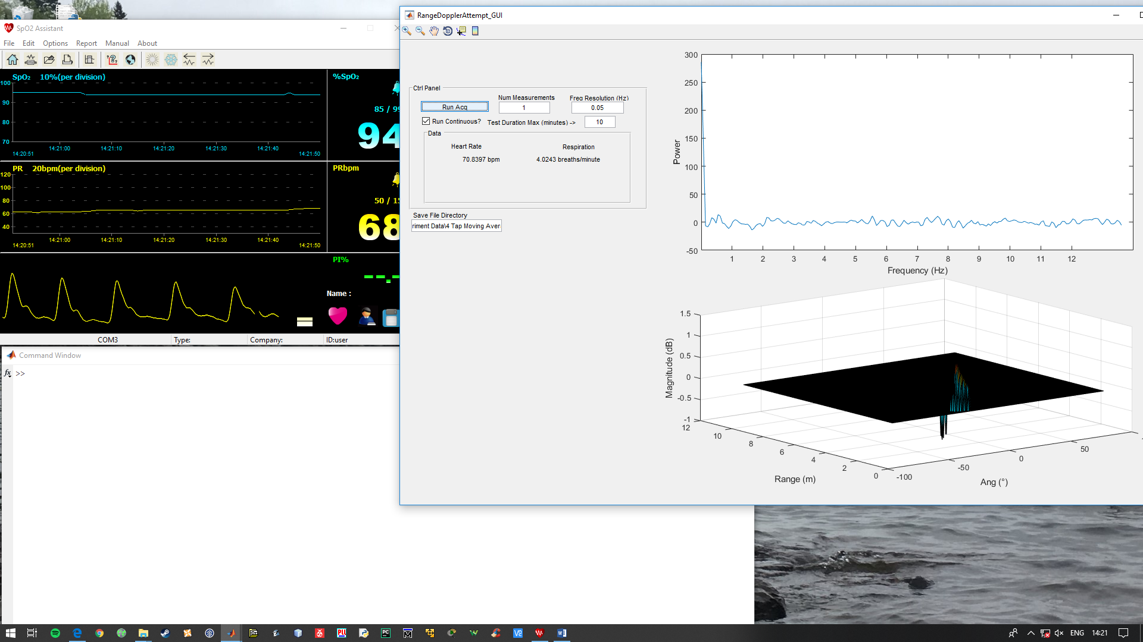
Previous Projects
Previous work done with the Demorad by Analog Devices has proven that it is possible to track the movement of multiple objects in the field of view of this device.
The end goal of this project is to design an application which can measure the heart-rate of a subject which is compatible with this previous work.

Slide 5
Ctnd.
Given the long history of this project, large parts of the research have been very well documented:
The first step is knowing how the project was done previously
Literature review shows that this idea first debuted in 1970’s, and has gone through many revisions since then. (J. C. Lin, J. Kiernicki, M. Kiernicki, P. B. J. I. T. o. M. T. Wollschlaeger, and Techniques, "Microwave apexcardiography," vol. 27, no. 6, pp. 618-620, 1979.Research the measurement)
Much is known about the movement of the heart in nearly every domain (time and frequency). Even the exact mechanical motion of the heart has been mapped to a highly accurate degree (Høst-Madsen, N. Petrochilos, O. Boric-Lubecke, V. M. Lubecke, B.-K. Park, and Q. Zhou, "Signal processing methods for Doppler radar heart rate monitoring," in Signal Processing Techniques for Knowledge Extraction and Information Fusion: Springer, 2008, pp. 121-140.)
Next, review other methods of taking the measurement
For the experiment to come a “Gold Standard” measurement will be required. Many options exist: Mechanical measurements, optical measurements, etc.

Slide 6
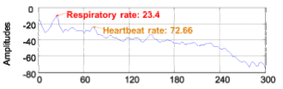
Ctnd.
W. Ser, J. Yu, X. Guo, J. Zhang, and M. E. H. Ong (in “Noncontact Heart Rate Measurement using 24 GHz Doppler Radar”) produced this frequency domain mapping of the chest wall movement, which I can take advantage of in this project.
per Minute

Slide 7
The Board
The Demorad is inherently a Multiple Input Multiple Output (MIMO) device, which has some useful properties:
Provides a very wide field-of-view (which was exploited for the tracking people project)
Also readily supports Digital Beam Forming, high resolution measurement which ports excellently to tracking multiple targets.
It does however lead to some costly computations, which can (and in this case does) slow down computation time. BIG PROBLEM
But enough is now known that a prototype design can be built.

Slide 8
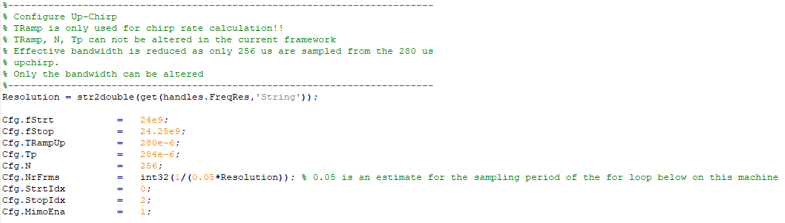
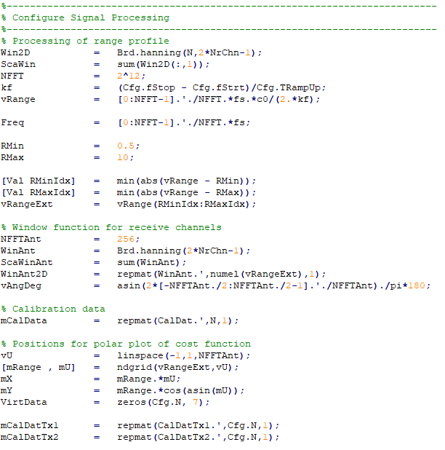
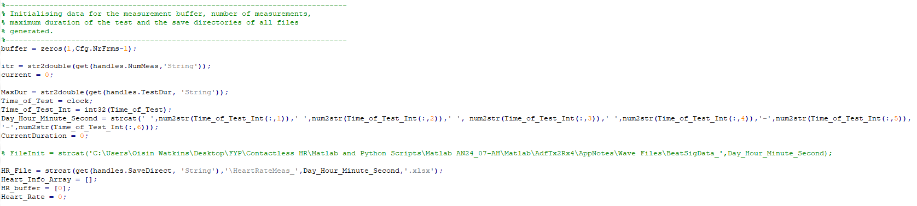
The Algorithm
Initialisation
Here will be a detailing of the code designed to undertake the heart rate measurement.
These first steps simply connect to the board and reserve memory for variables needed to run the measurement.
Runtime is essentially negligible
No complex tasks performed, no improvements to efficiency really possible/necessary

Slide 9
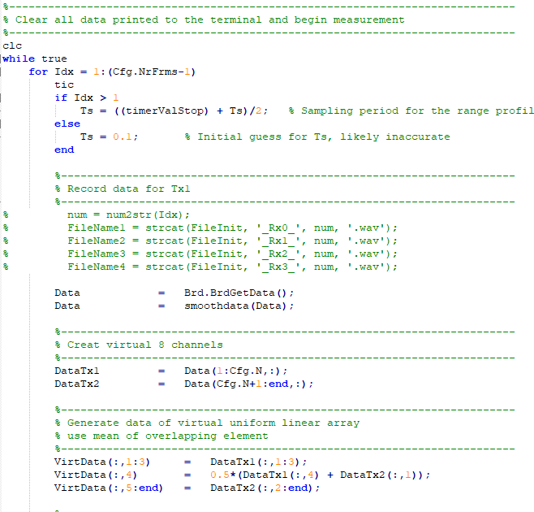
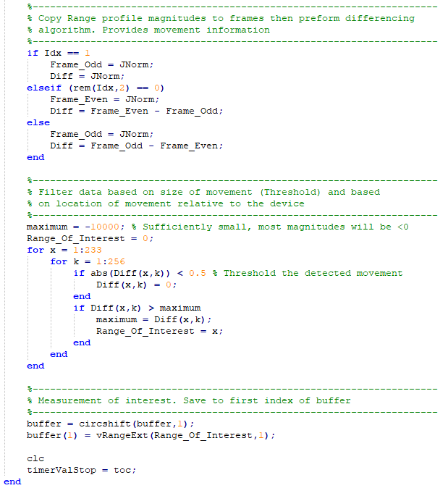
Data Capture
Here is where the measurement happens.
How the data gathered in this section is processed (next slide) drastically different performances can be achieved.
Runtime: Roughly 8s per measurement, subject to variability in the post-processing to come
Efficiency: Numerous complex tasks performed here;
the timing of the loop
the differencing algorithm
searching the ranged-profile for the target
These operations are simple in idea, however they require long iterative loops.

Slide 10
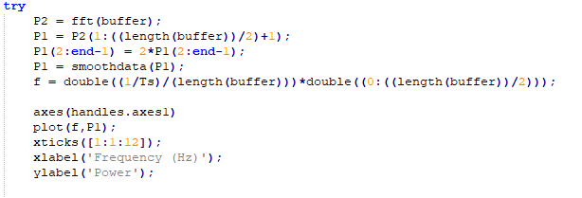
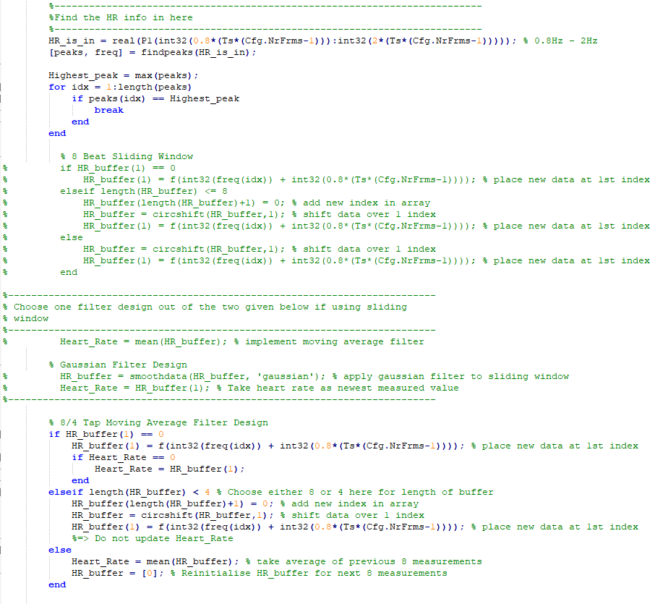
Post Processing
Performing FFT’s, filtering and saving data.
Also some loop timing control in there.
Runtime: Of the 8s spent in the loop, on average 3s were spent in this section. Rather inefficient.
Efficiency: Certain sections of code should be removed altogether to improve performance:
Respiratory action should not be measured at all
The filtering performed is slow, this requires optimisation
The control sequences are as efficient as can be, if-else statements are negligible.

Slide 11
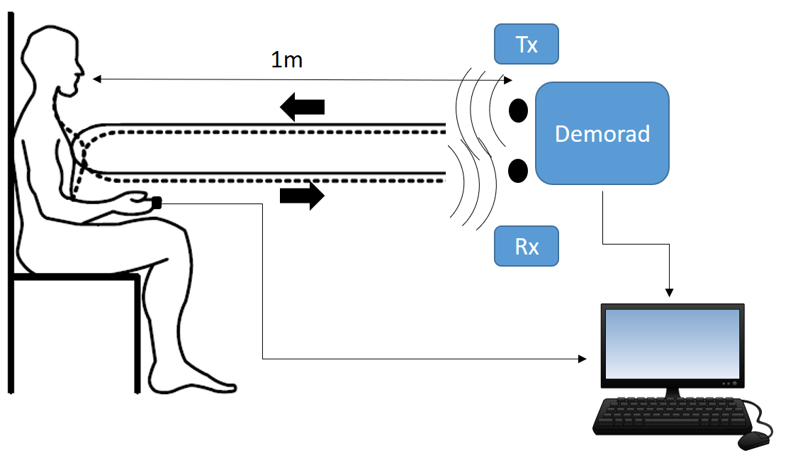
Testing the design
This test will follow a fairly intuitive layout, shown in this simplified diagram:

Slide 12
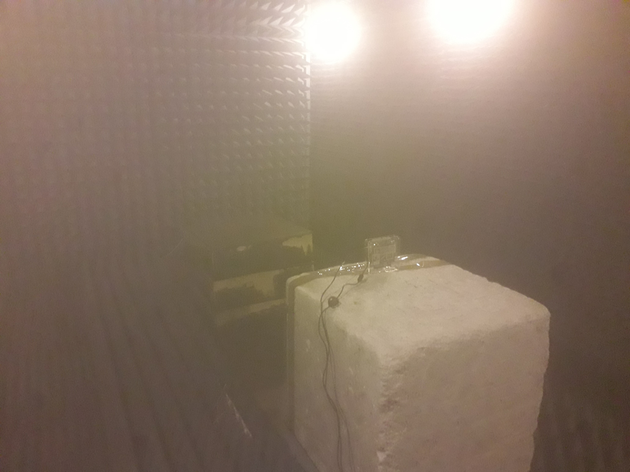
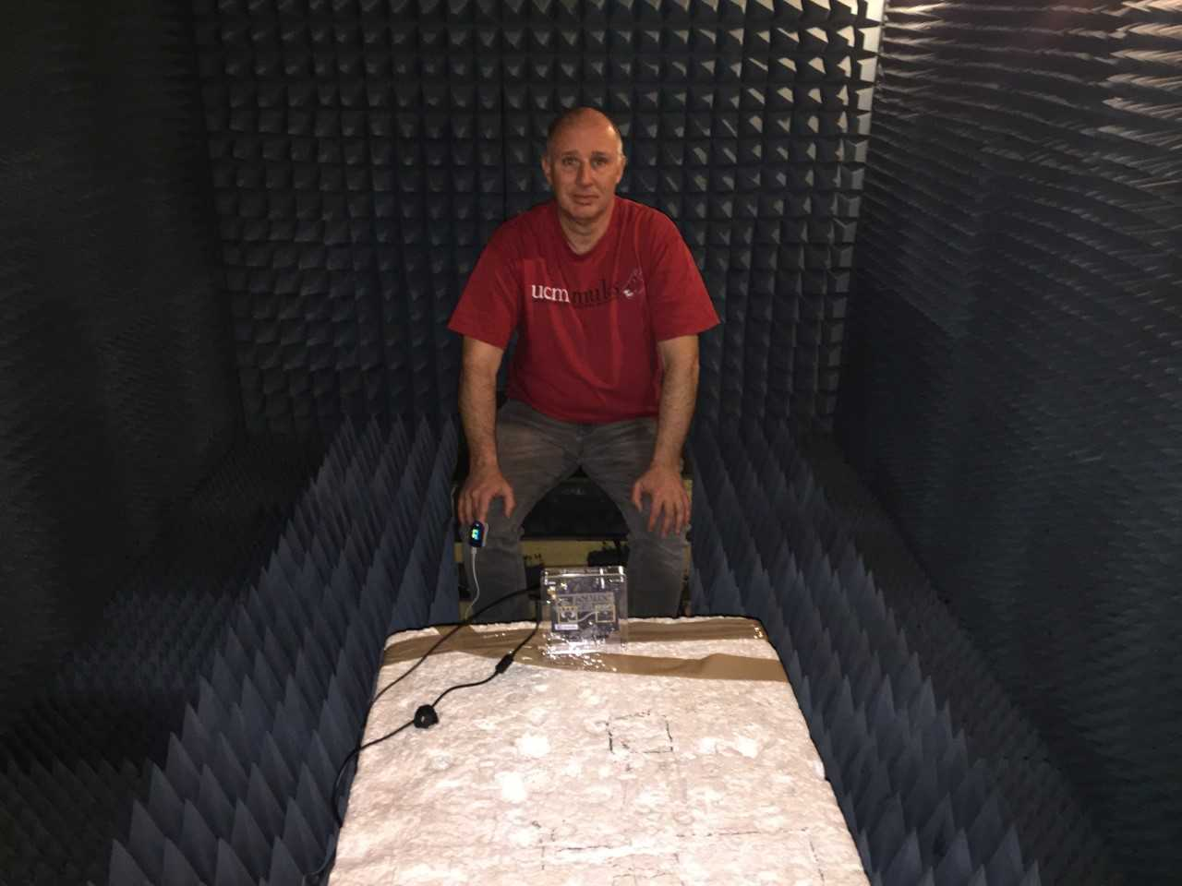
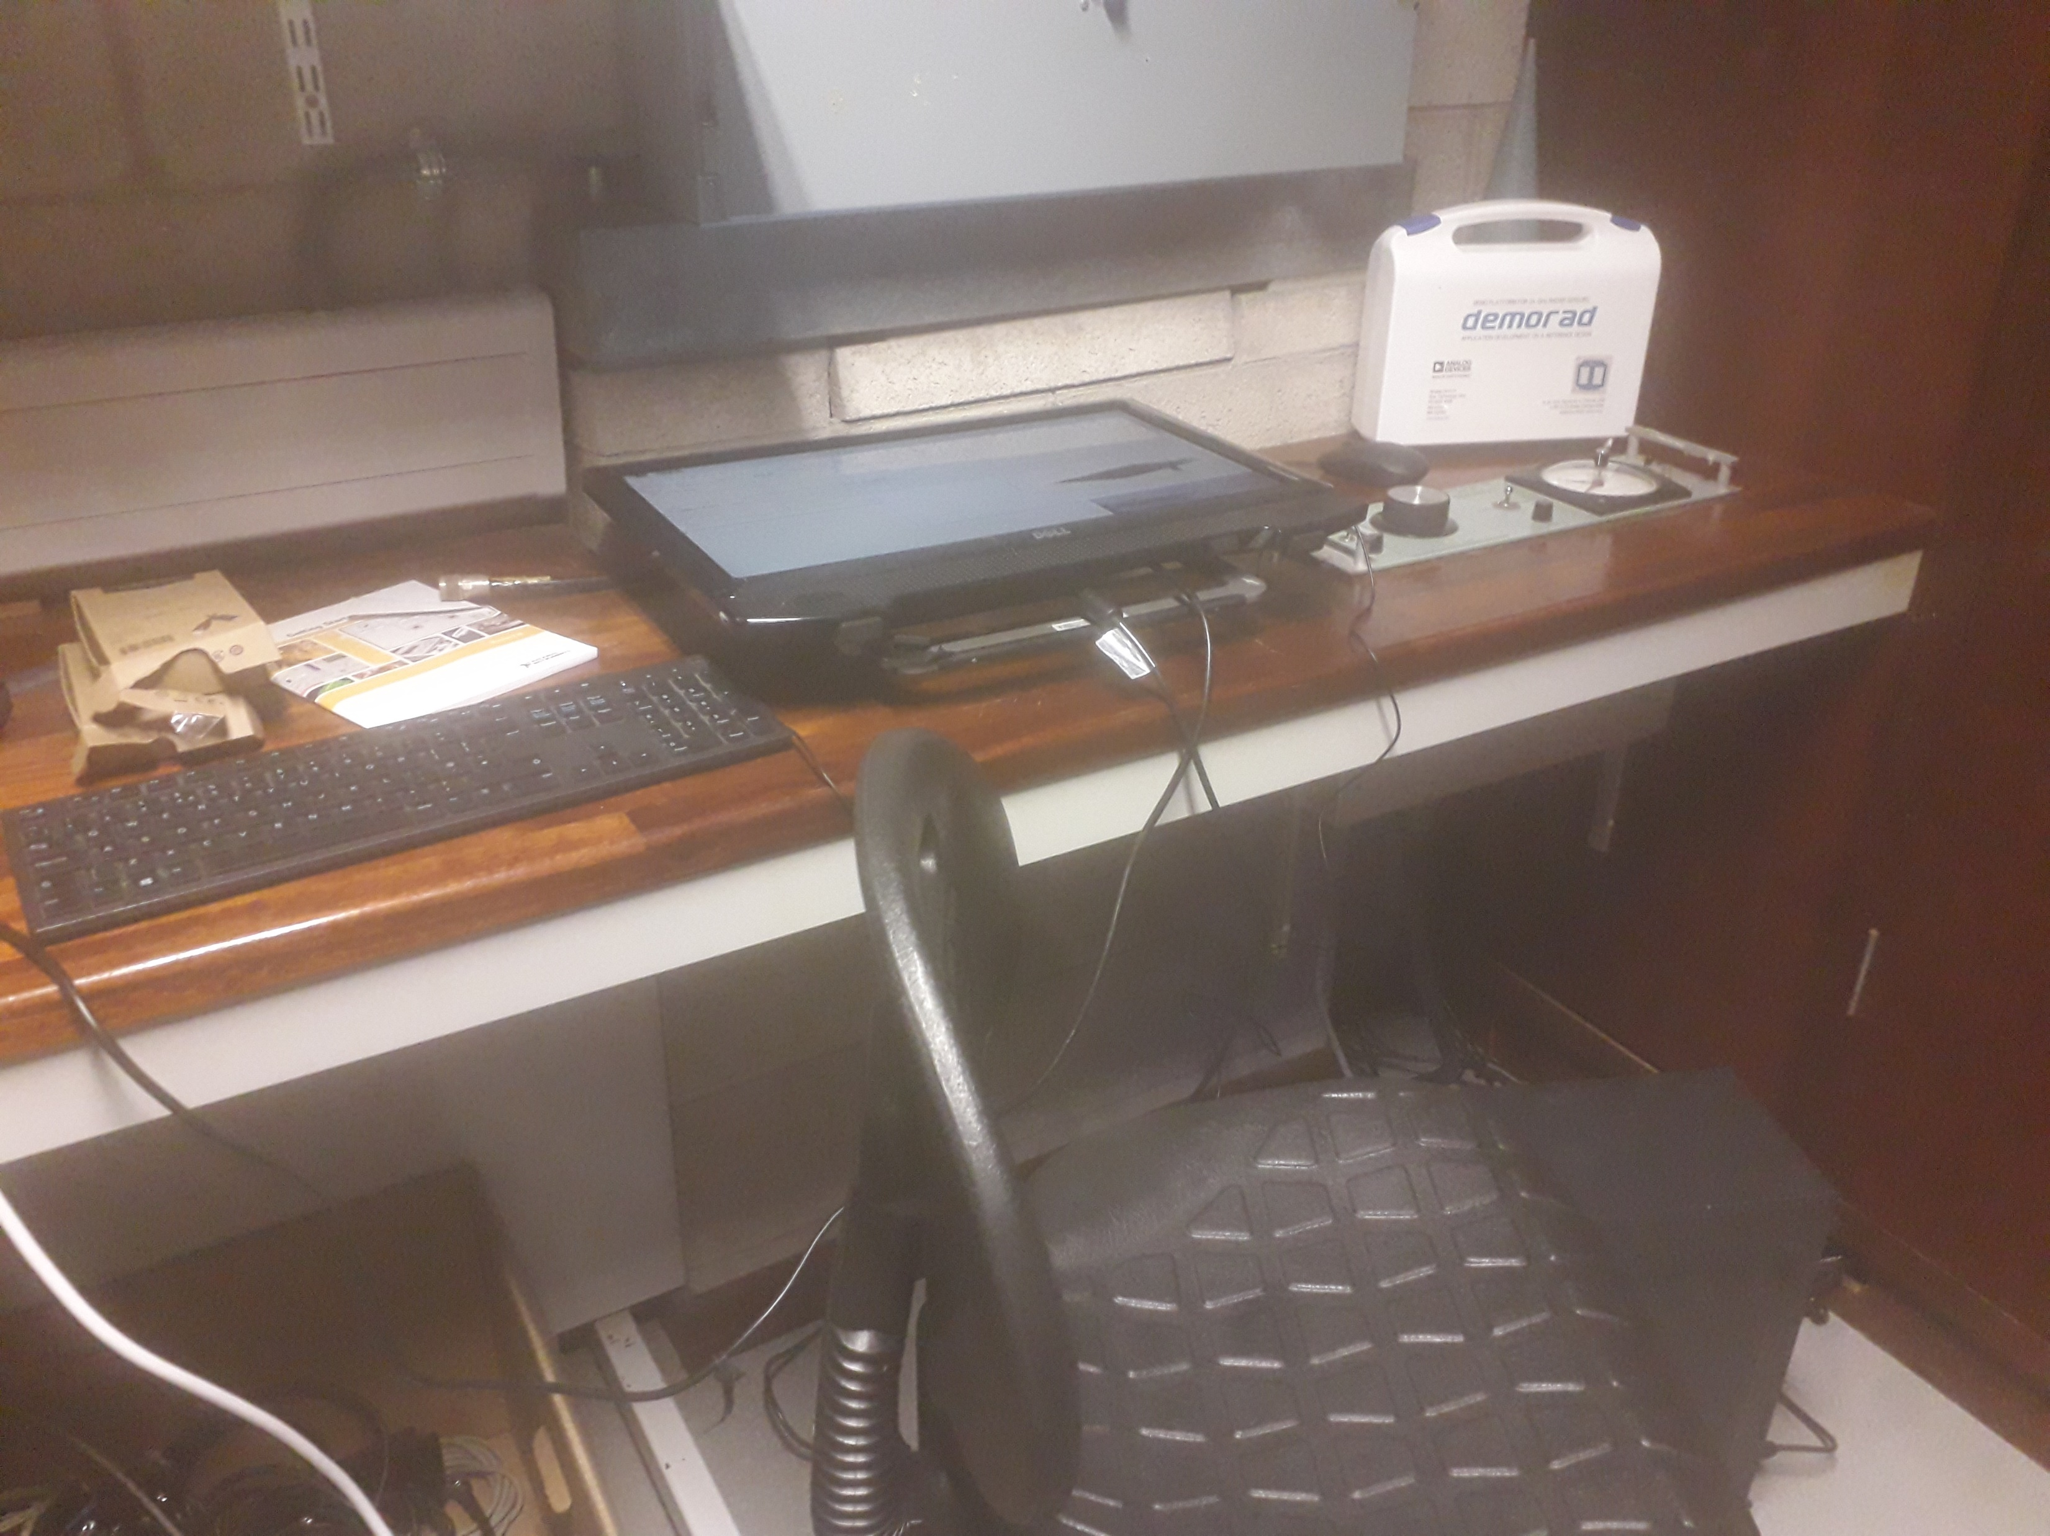
Ctnd.
The measurements were taken in the Anechoic chamber in C-block of the main building. Regrettably the specifications of this chamber were lost and need to be reacquired.

Slide 13
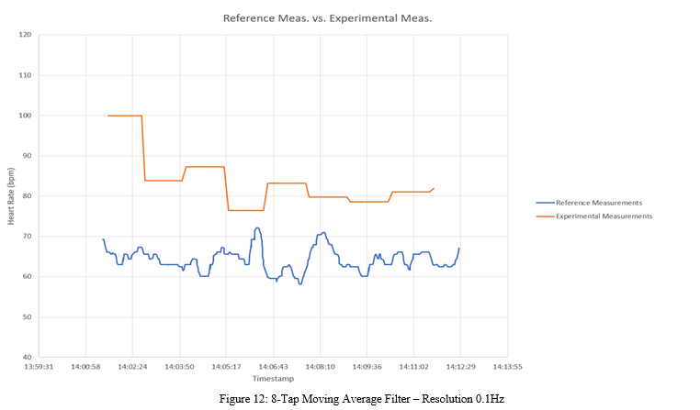
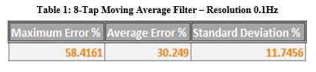
Results

Slide 14
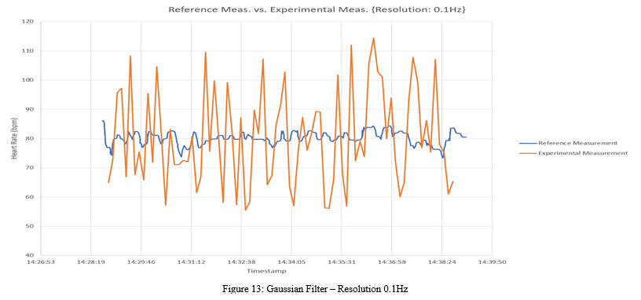
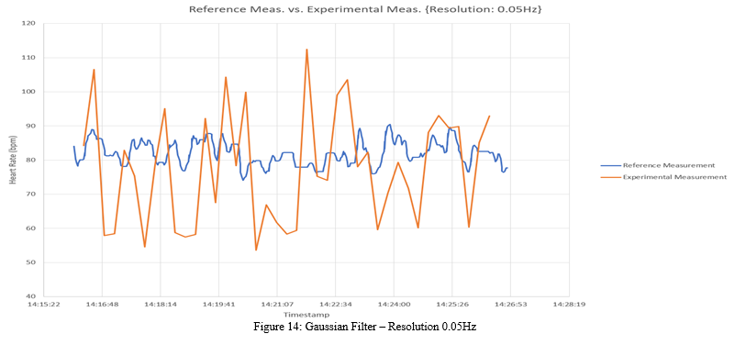
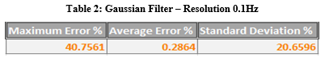
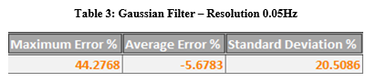

Slide 15
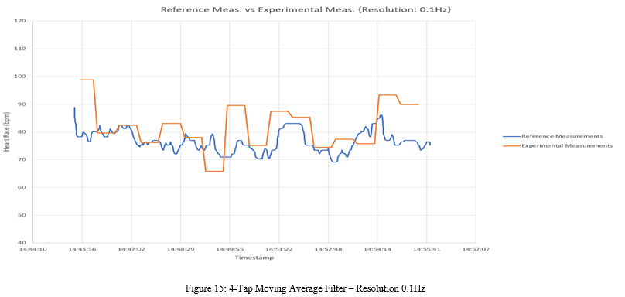
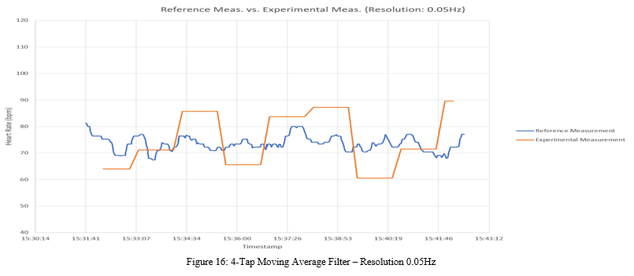
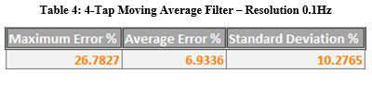
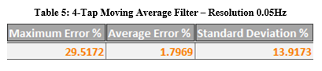

Slide 16
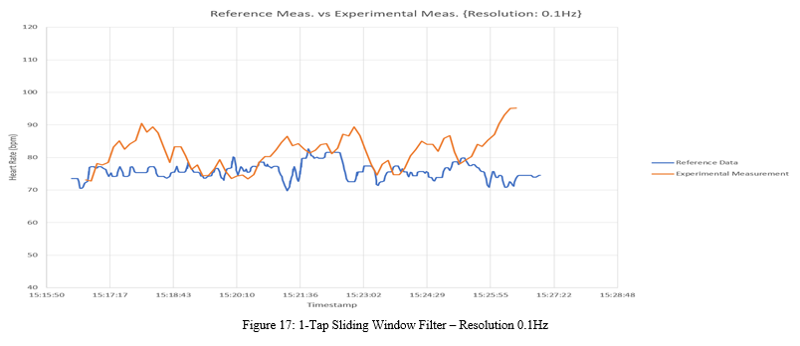
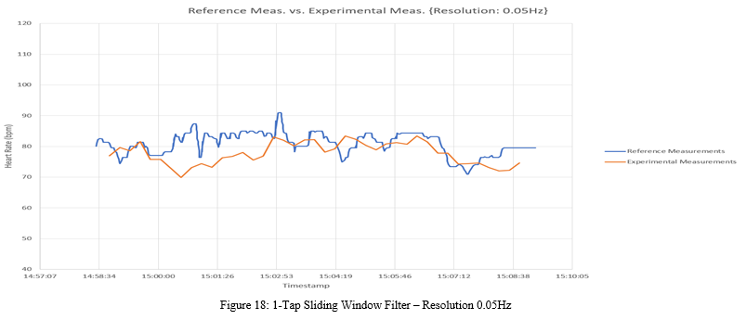
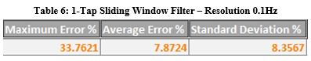
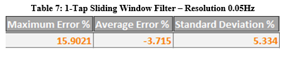

Slide 17
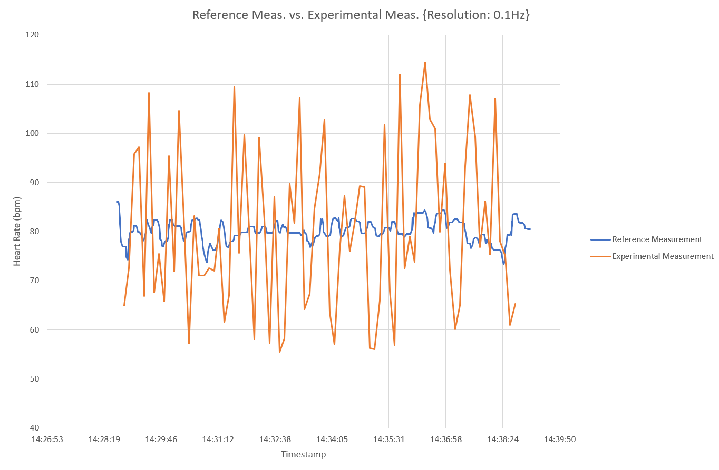
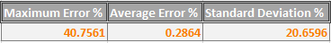
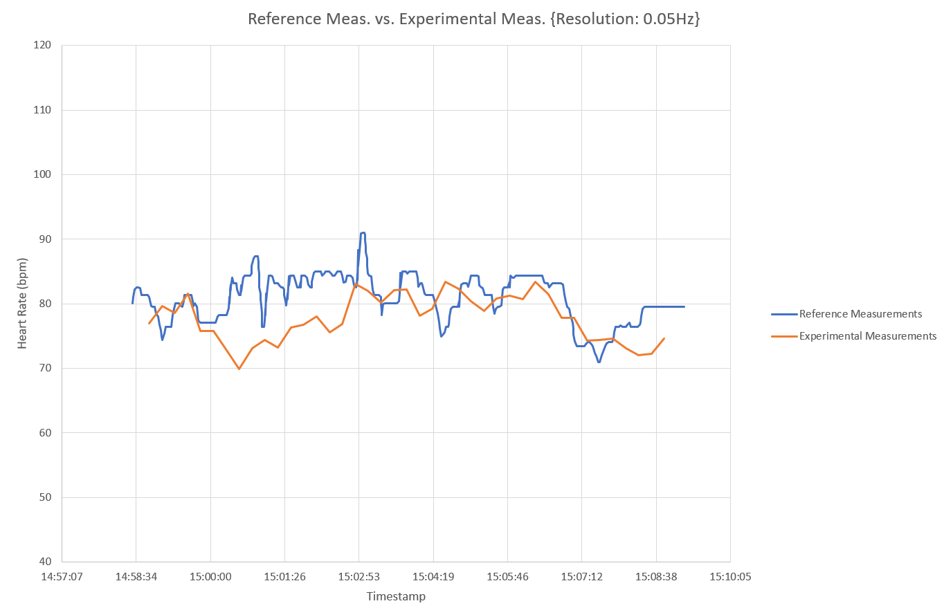
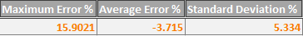
The Data
Each design has been evaluated using Maximum error, Mean percentage error (average error) and standard deviation of the error.
To the right is shown the time-series captures from the best and one of the worse designs tested.

Slide 18
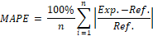
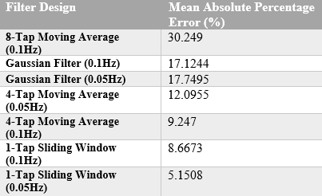
Luckily there are other metrics, such as Mean Absolute Percentage Error:
Accounts size of error without being biased when given zero-centered error.
Can have problems when the reference measurement falls to zero, however my test subject was never dead so that wasn’t an issue.

Slide 19
Conclusions
Accuracy of 94.85% reached.
Test was only carried out on one subject, due to time constraints. Gathering enough data to perform Method Comparison analysis would be the ideal next step.
There are also other ideas I’d like to give a try to, but those can wait for the time being.
Thank you all for listening!

Slide 20


